Slide 1


Metrology & Predictive Design
For Synthetic Biology
Jacob Beal
November, 2013

Slide 2
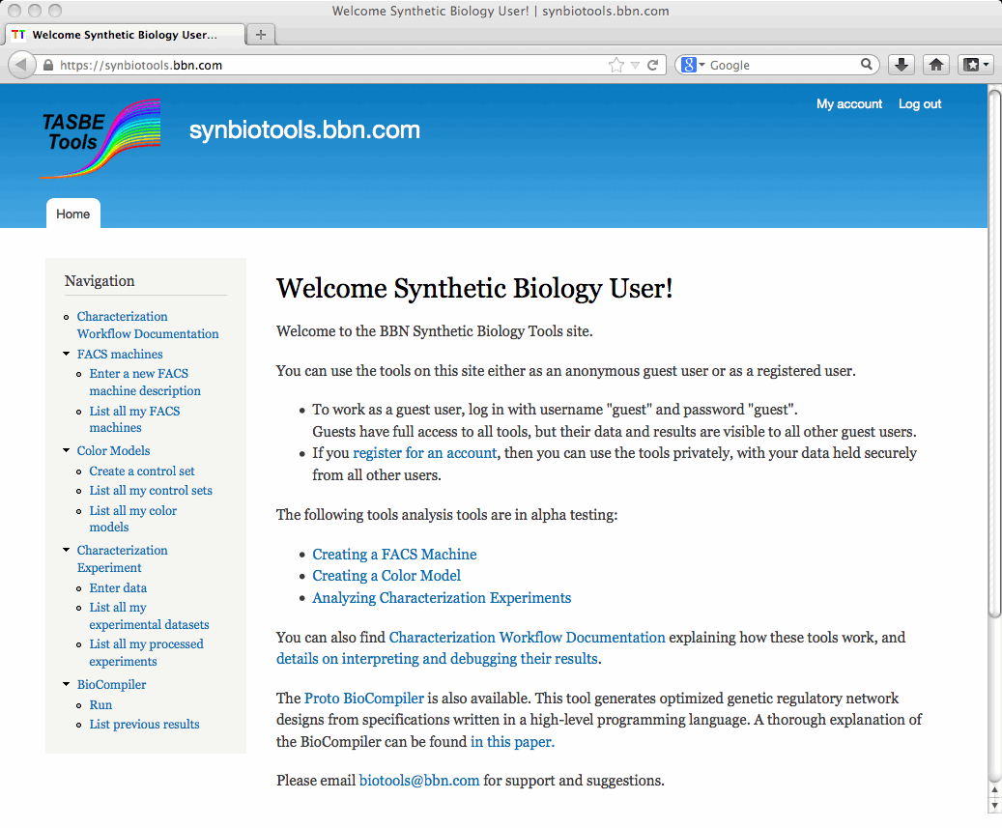
Bringing Wet & Dry Together…
Dilution
& decay
Delay
I(t)
P(I,t)
+
O(t)
Deeper Understanding
Computer science
tools and models
Reliable Engineering
IPTG
not
green
IPTG
A
outputs
arg0
B
outputs
LacI
outputs
arg0
GFP
IPTG
LacI
A
B
GFP

Slide 3
Outline
Vision and Motivation
Proto BioCompiler
Calibrating Flow Cytometry
Building EQuIP Models
Prediction & Validation

Slide 4
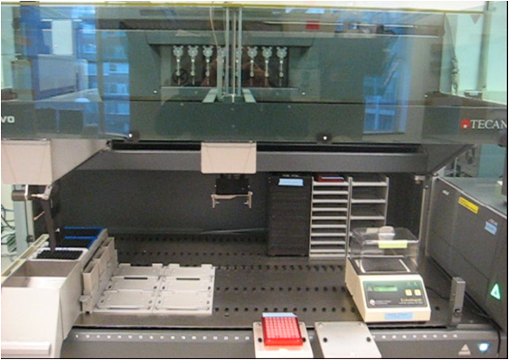

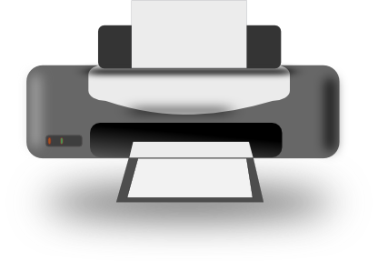
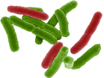

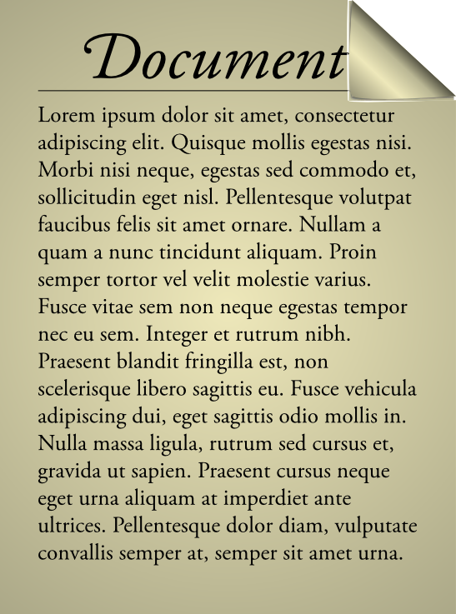
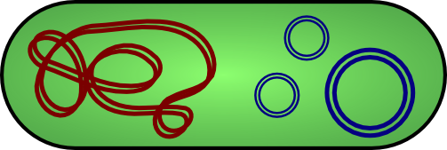
Vision: WYSIWYG Synthetic Biology
Bioengineering should be like document preparation:

Slide 5
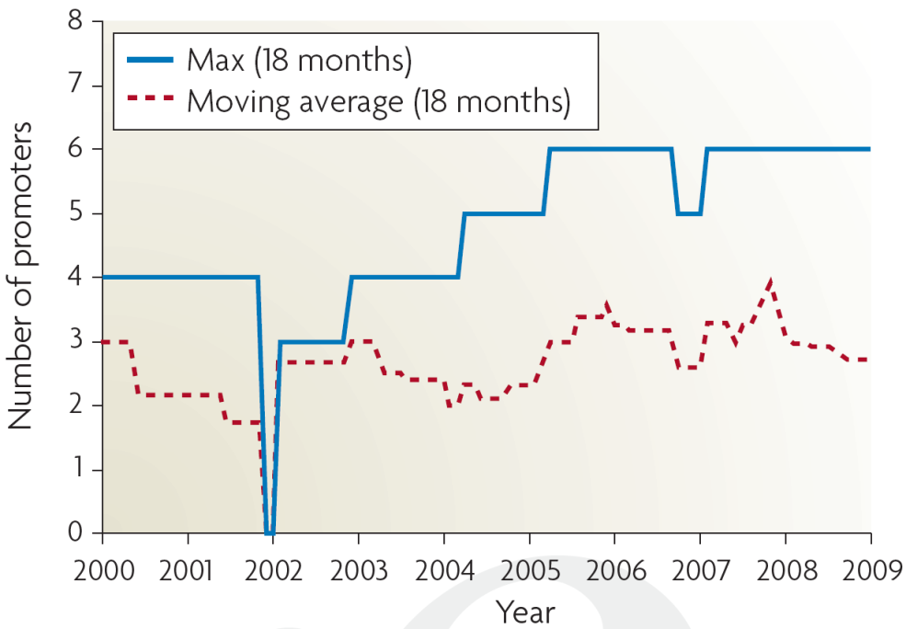
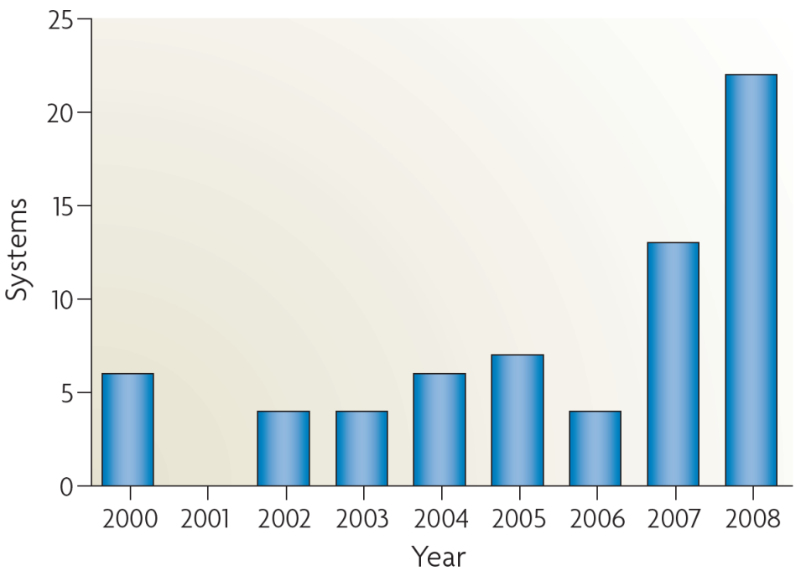
Why is this important?
Breaking the complexity barrier:
Multiplication of research impact
Reduction of barriers to entry
?
DNA synthesis
Circuit size
[Purnick & Weiss, ‘09]
*Sampling of systems in publications with experimental circuits

Slide 6
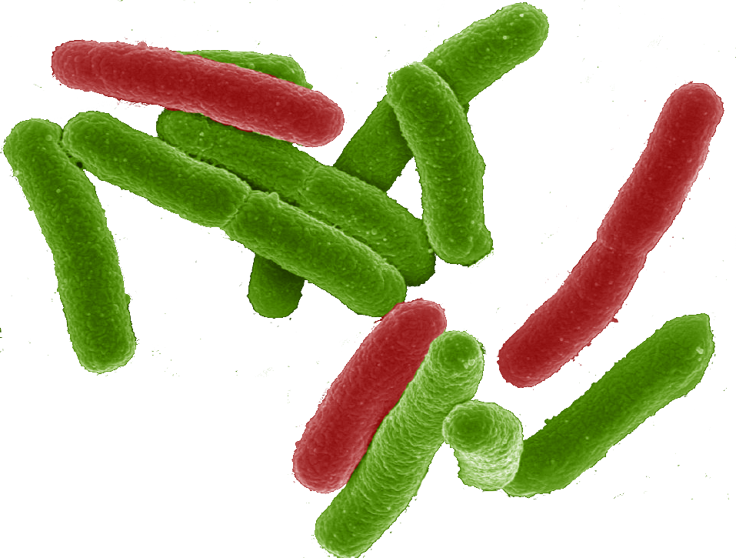
Why a tool-chain?
Organism Level Description
This gap is too big to cross with a single method!
Cells

Slide 7
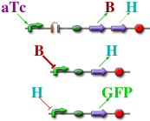
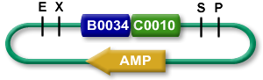

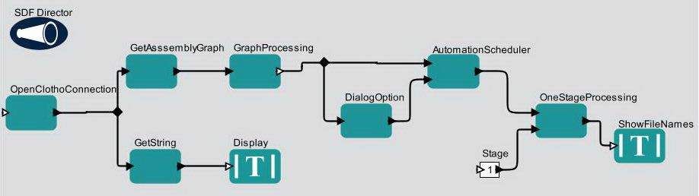

TASBE tool-chain
Organism Level Description
High level simulator
High Level Description
If detect explosives:
emit signal
If signal > threshold:
glow red
Coarse chemical simulator
Abstract Genetic Regulatory Network
Detailed chemical simulator
DNA Parts Sequence
Modular architecture also open for flexible choice of organisms, protocols, methods, …
Collaborators:
Assembly Instructions
Ron
Weiss
Testing
Douglas Densmore
Cells
[Beal et al, ACS Syn. Bio. 2012]

Slide 8
A Tool-Chain Example
A high-level program of a system that reacts depending on sensor output
If detect explosives:
emit signal
If signal > threshold:
glow red
(def simple-sensor-actuator ()
(let ((x (test-sensor)))
(debug x)
(debug-2 (not x))))
Mammalian Target
E. coli Target
[Beal et al, ACS Syn. Bio. 2012]

Slide 9
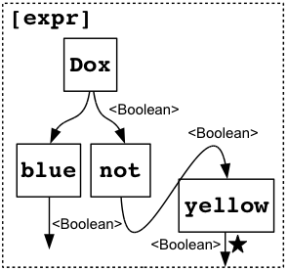
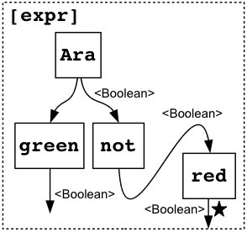
A Tool-Chain Example
Program instantiated for two target platforms
If detect explosives:
emit signal
If signal > threshold:
glow red
Mammalian Target
E. coli Target
[Beal et al, ACS Syn. Bio. 2012]

Slide 10
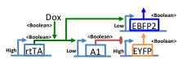
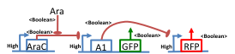
A Tool-Chain Example
Abstract genetic regulatory networks
If detect explosives:
emit signal
If signal > threshold:
glow red
Mammalian Target
E. coli Target
[Beal et al, ACS Syn. Bio. 2012]

Slide 11
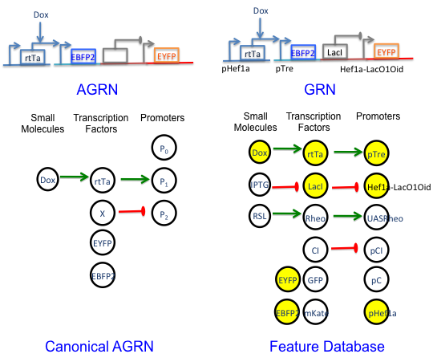
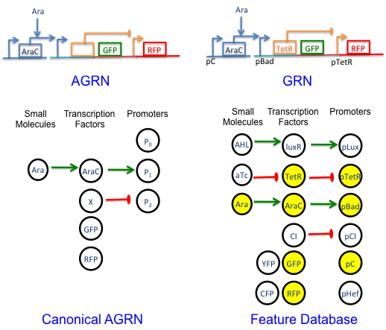
A Tool-Chain Example
Automated part selection using database of known part behaviors
If detect explosives:
emit signal
If signal > threshold:
glow red
Mammalian Target
E. coli Target
[Beal et al, ACS Syn. Bio. 2012]

Slide 12
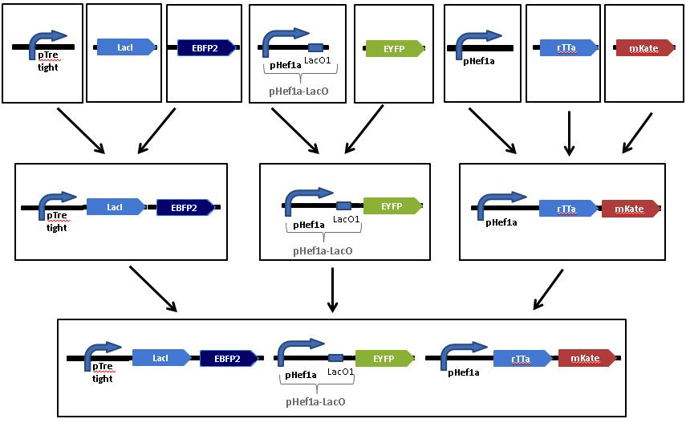
A Tool-Chain Example
Automated assembly step selection for two different platform-specific assembly protocols
If detect explosives:
emit signal
If signal > threshold:
glow red
Mammalian Target
E. coli Target
[Beal et al, ACS Syn. Bio. 2012]

Slide 13
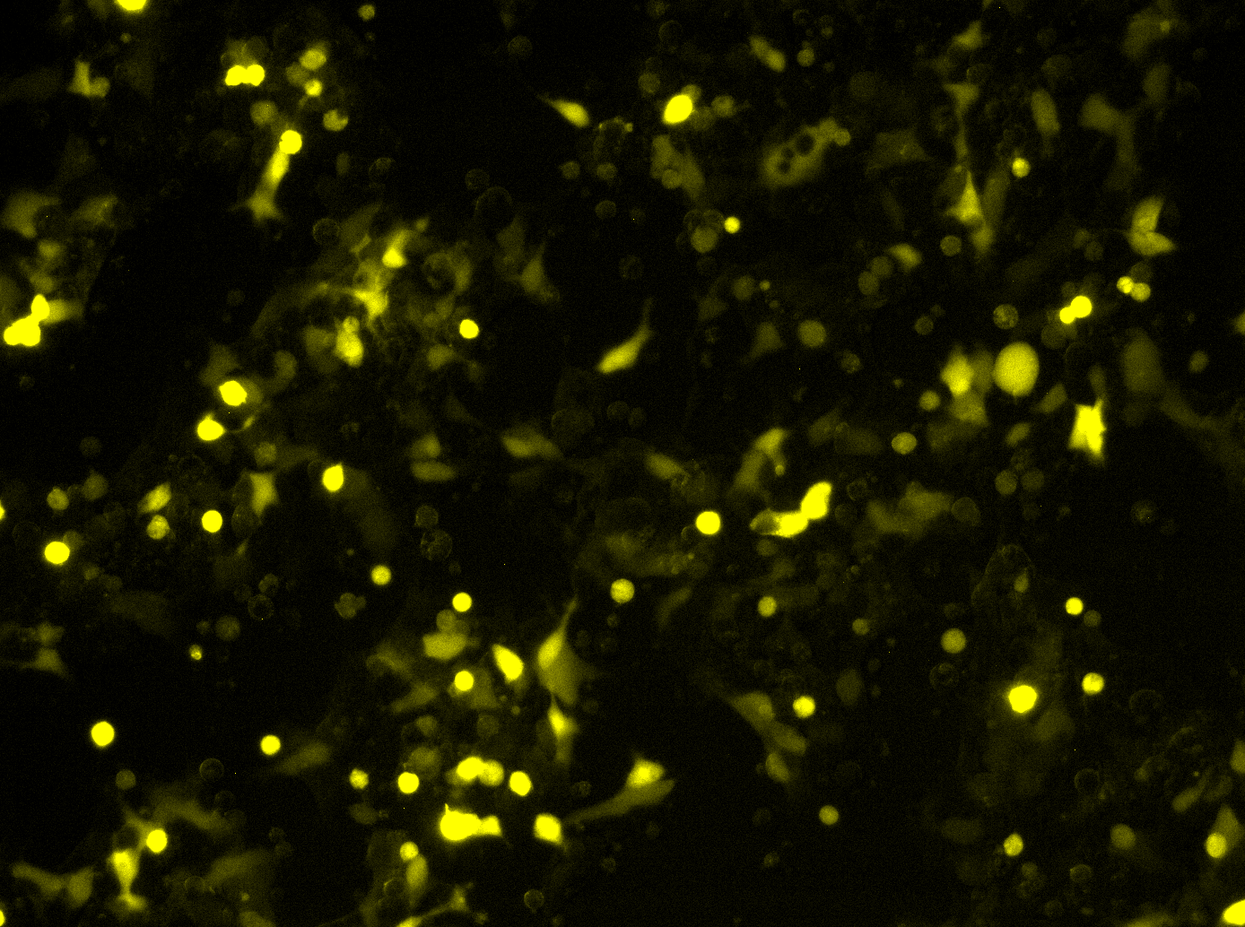
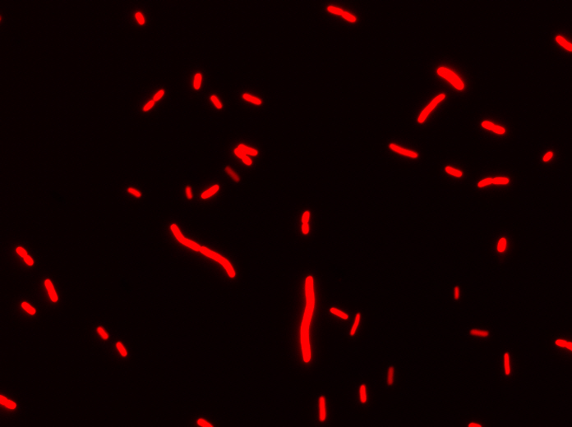
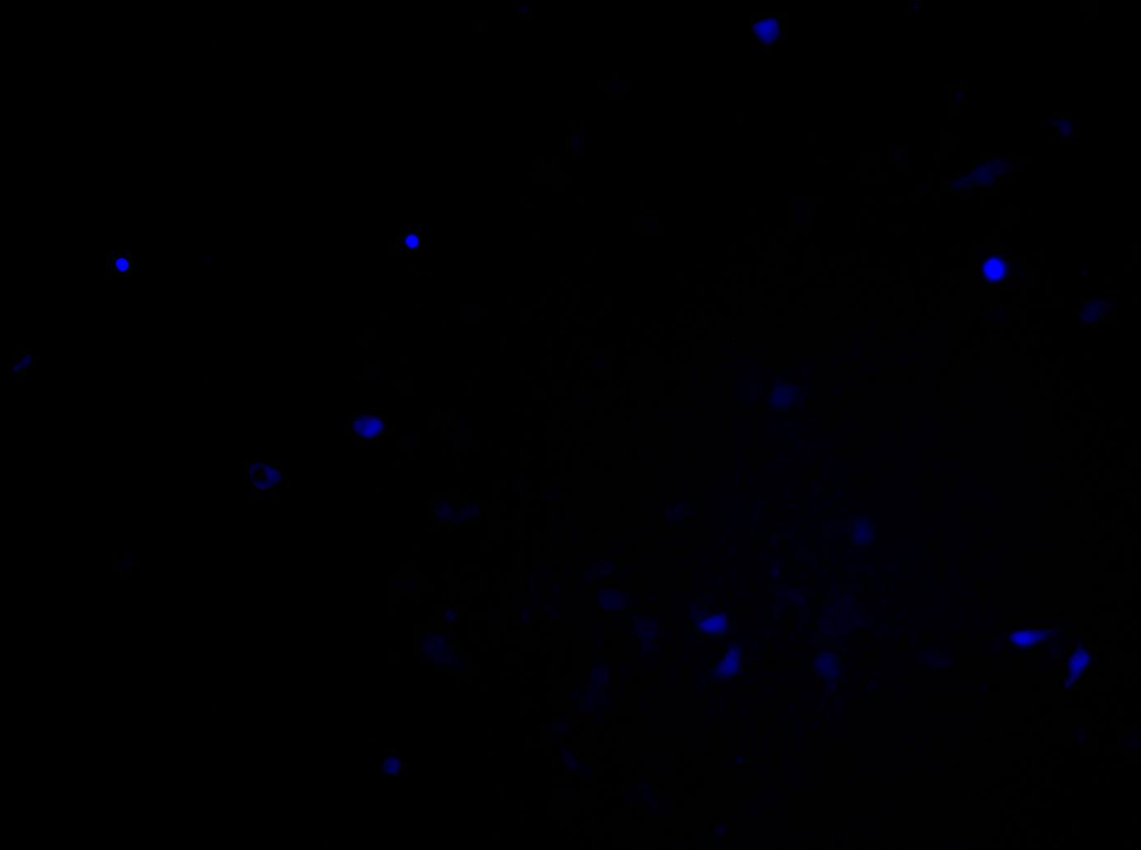
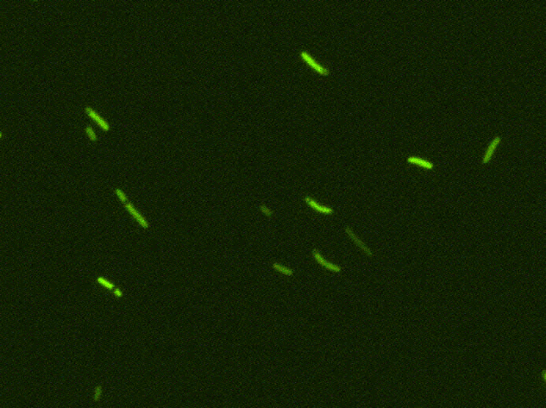
A Tool-Chain Example
Resulting cells demonstrating expected behavior
Uninduced
Uninduced
If detect explosives:
emit signal
If signal > threshold:
glow red
Induced
Induced
Mammalian Target
E. coli Target
[Beal et al, ACS Syn. Bio. 2012]

Slide 14
Outline
Vision and Motivation
Proto BioCompiler
Calibrating Flow Cytometry
Building EQuIP Models
Prediction & Validation

Slide 15
Focus: BioCompiler
Organism Level Description
High level simulator
High Level Description
Compilation &
Optimization
If detect explosives:
emit signal
If signal > threshold:
glow red
Coarse chemical simulator
Abstract Genetic Regulatory Network
Detailed chemical simulator
DNA Parts Sequence
Other tools aiming at
high-level design:
Cello, Eugene, GEC,
GenoCAD, etc.
Assembly Instructions
Testing
Cells
[Beal, Lu, Weiss, 2011]

Slide 16
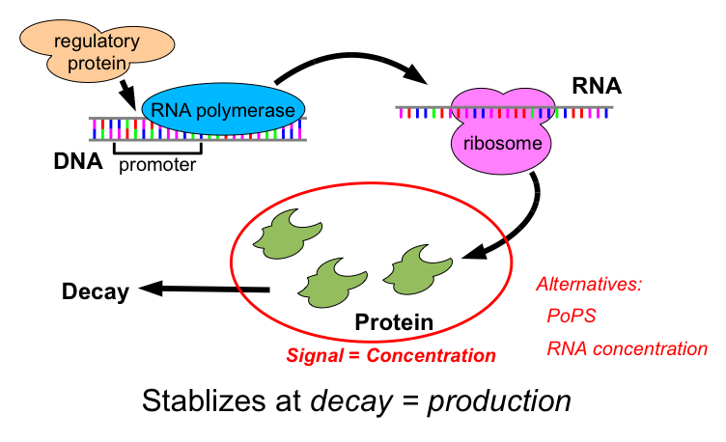
Transcriptional Logic Computations

Slide 17
Motif-Based Compilation
Operators translated to motifs:
IPTG
not
green
IPTG
A
B
LacI
outputs
arg0
outputs
arg0
GFP
outputs
IPTG
LacI
A
B
GFP

Slide 18
Design Optimization
(def sr-latch (s r)
(letfed+ ((o boolean (not (or r o-bar)))
(o-bar boolean (not (or s o))))
o))
(green (sr-latch (aTc) (IPTG)))
IPTG
GFP
LacI
B
I
F
E1
E2
D
I
aTc
C
J
H
G
TetR
A
J
Unoptimized: 15 functional units, 13 transcription factors

Slide 19
Design Optimization
(def sr-latch (s r)
(letfed+ ((o boolean (not (or r o-bar)))
(o-bar boolean (not (or s o))))
o))
(green (sr-latch (aTc) (IPTG)))
IPTG
F
GFP
H
LacI
TetR
aTc
Final Optimized:
5 functional units
4 transcription factors
H
F
Unoptimized: 15 functional units, 13 transcription factors

Slide 20
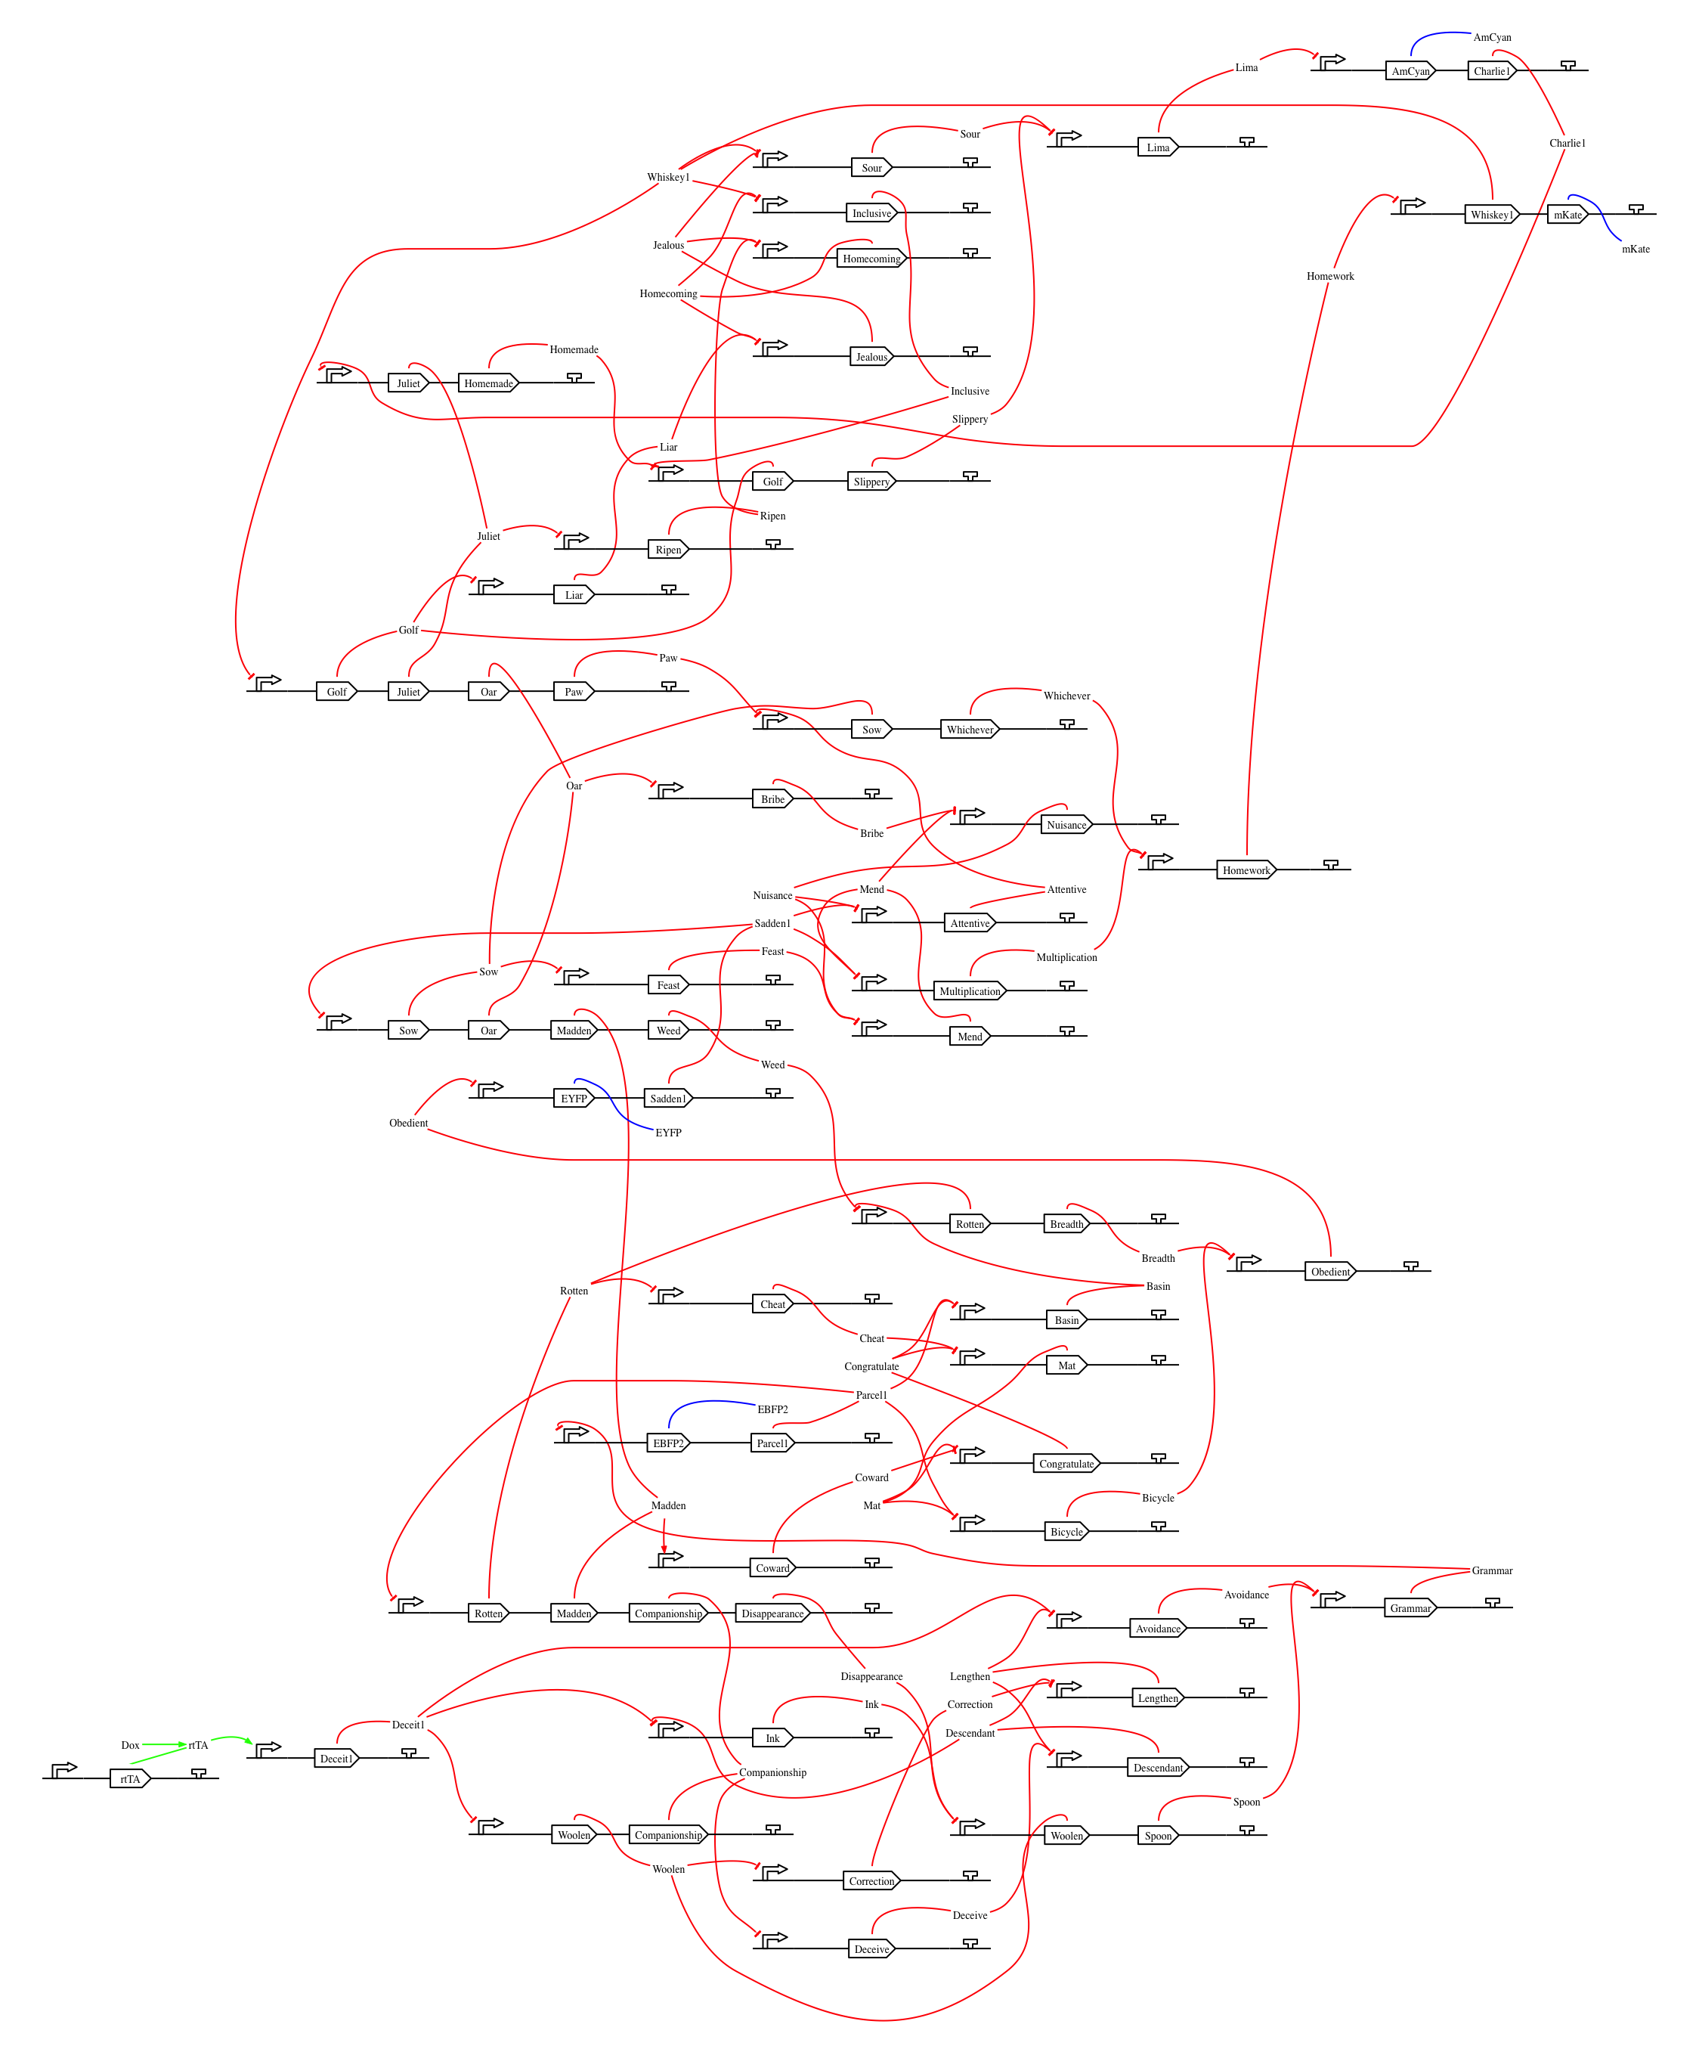
Complex Example: 4-bit Counter
(4-bit-counter)
compiled for mammalian
Optimized compiler already outperforms human designers

Slide 21
Barriers & Emerging Solutions:
Barrier: Availability of High-Gain Devices
Emerging Solution: combinatorial device libraries based on TALs, ZFs, miRNAs
Barrier: Characterization of Devices
Emerging solution: TASBE characterization method
Barrier: Predictability of Biological Circuits
Emerging solution: EQuIP prediction method

Slide 22
Outline
Vision and Motivation
Proto BioCompiler
Calibrating Flow Cytometry TASBE Method
Building EQuIP Models
Prediction & Validation
[Beal et al., Technical Report: MIT-CSAIL-TR-2012-008, 2012]

Slide 23
First, some metrology…
R1
R2
Output
[R2]
[Output]
Arbitrary Blue
Arbitrary Blue
[R1]
[R2]
Arbitrary Red
Arbitrary Red
Unit mismatch!

Slide 24
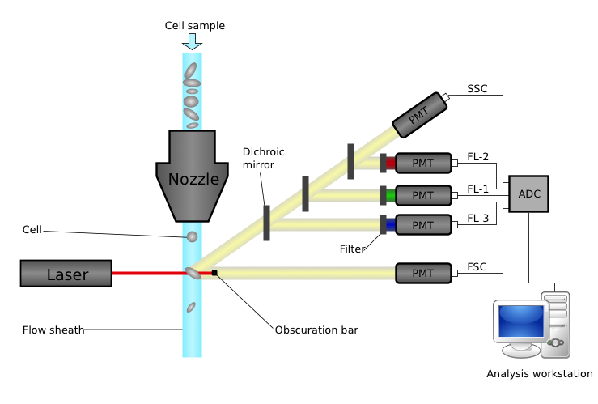
How Flow Cytometry Works
Challenges:
Autofluorescence
Variation in measurements
Spectral overlap
Time Contamination
Lots of data points!
Different protein fluorescence
Individual cells behave (very) differently

Slide 25
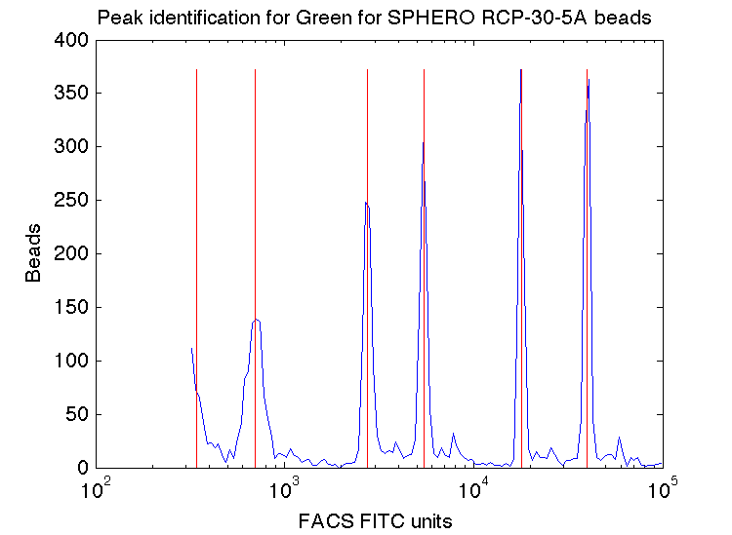
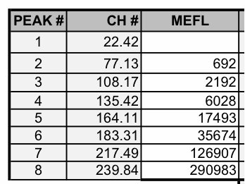
Fluorescent Beads → Absolute Units
SpheroTech RCP-30-5A
Run beads every time: flow cytometers drift up to 20 percent!
Also can detect instrument problems, mistakes in settings

Slide 26
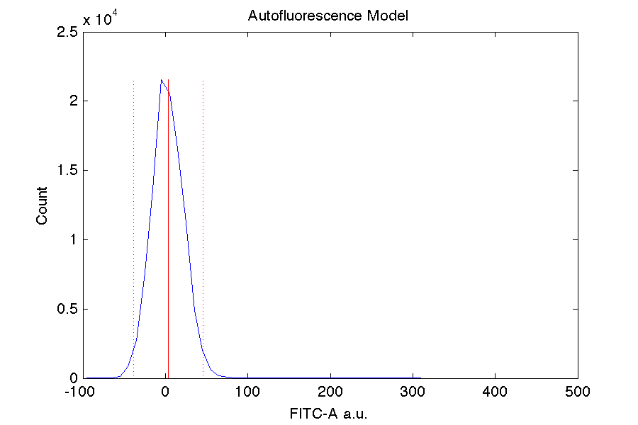
Compensating for Autofluorescence
Negative control used for this

Slide 27
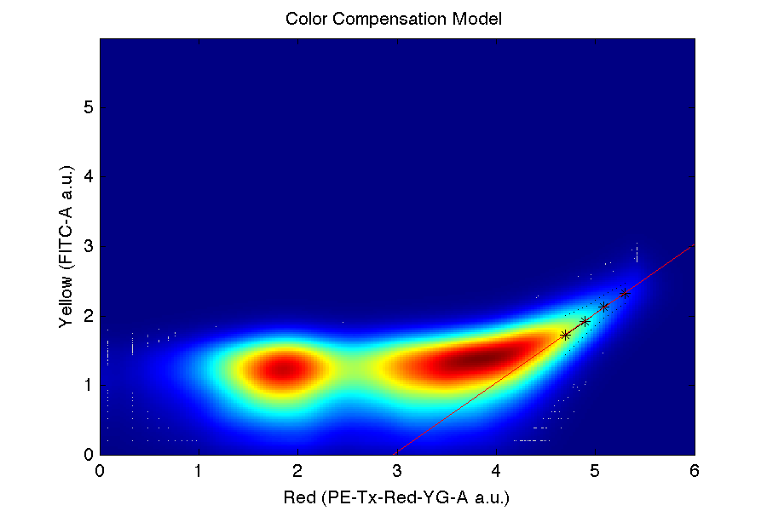
Compensating for Spectral Overlap
Strong positive control used for each color
Note: only linear when autofluorescence subtracted

Slide 28
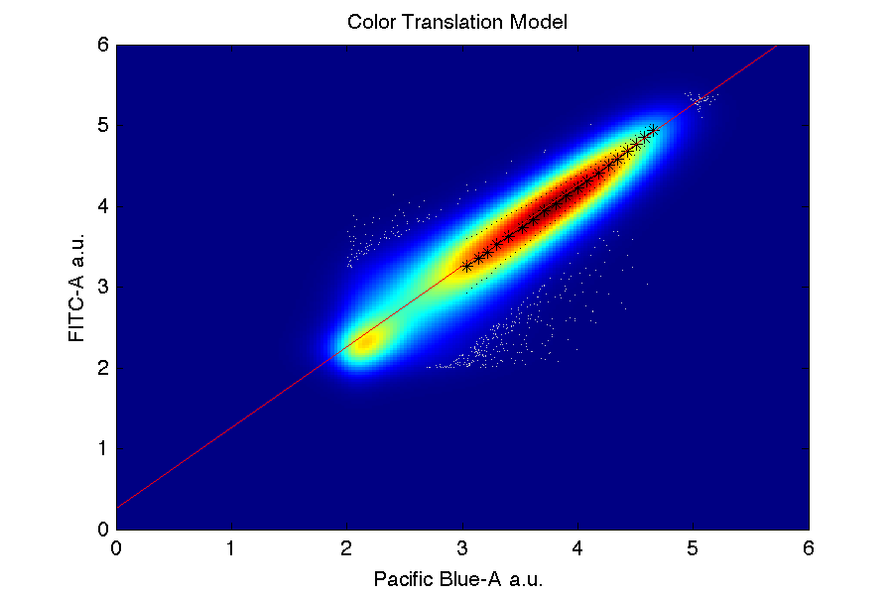
Translating Fluorescence to MEFL
Only FITC channel (e.g. GFP) goes directly
Others obtained from triple/dual constitutive controls
Must have exact same constitutive promoter!
Must have a FITC control protein!

Slide 29
Outline
Vision and Motivation
Proto BioCompiler
Calibrating Flow Cytometry
Building EQuIP Models
Prediction & Validation
[Davidsohn et al., IWBDA, 2013]

Slide 30
TASBE Characterization Method
Dox
R1
Output
Dox
pCAG
rtTA3
T2A
VP16Gal4
EBFP2
pCAG
mkate
pCAG
pTRE
pTRE
R1
pUAS-Rep1
EYFP
Transient cotransfection of 5 plasmids
Calibrated flow cytometry
Analysis by copy-count subpopulations

Slide 31
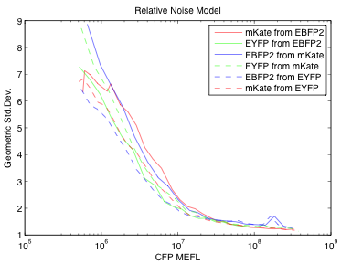
Multi-plasmid cotransfection!?!
Avoids all problems with adjacency, plasmid size, sequence validations
Variation appears to be independent

Slide 32
Result: Input/Output Relations
Transfer curve for TAL 14
Transfer curve for TAL 21
R1 = TAL14
R1 = TAL21

Slide 33
Expression Dynamics
Fraction Active
Mean Expression
Results → division rate, mean expression time, production scaling factor

Slide 34

EQuIP model
Regulated Production
Loss
λ
…
ΔOutput
Input(t)
Output(t)
Time
Input
Model = first-order discrete-time approximation

Slide 35
Outline
Vision and Motivation
Proto BioCompiler
Calibrating Flow Cytometry
Building EQuIP Models
Prediction & Validation
[Davidsohn et al., IWBDA, 2013]

Slide 36
EQuIP Prediction
+
Dox
R1
R2
Output
Dox
pCAG
rtTA3
T2A
VP16Gal4
pTRE
EBFP2
pCAG
R1
R2
EYFP
pCAG
mkate
pTRE
pUAS-Rep1
pUAS-Rep2
Regulated Production
Loss
Regulated Production
Loss
λ
λ
…
…
ΔOutput
ΔOutput
Input(t)
Time
Time
Output(t)
Input
Input

Slide 37
Incremental Discrete Simulation
[TAL21]
[TAL14]
[OFP]
TAL14
OFP
TAL14
production
OFP
production
TAL21
state
TAL14
state
OFP
state
time
+
+
production
hour 1
loss
-
-
-
+
+
production
hour 2
loss
…
…
…
-
-
-
production
+
+
hour 46

Slide 38
High Quality Cascade Predictions
1.6x mean error on 1000x range!
TAL14 → TAL21
TAL21 → TAL14
Circles = EQuIP predictions
Crosses = Experimental Data

Slide 39
Summary
Automation supports design and debugging of biological devices, sensors, actuators, circuits
BioCompiler automates regulatory network design
TASBE method calibrates flow cytometry data
Cotransfected test circuits give good models
EQuIP accurately predicts cascade behavior from models of individual repressors
Looking forward:
Real measurements → good engineering
Bigger, better circuits on more platforms
[multiple manuscripts in preparation]

Slide 40

Acknowledgements:
Aaron Adler
Joseph Loyall
Rick Schantz
Fusun Yaman
Ron Weiss
Jonathan Babb
Noah Davidsohn
Ting Lu
Douglas Densmore
Evan Appleton
Swapnil Bhatia
Traci Haddock
Chenkai Liu
Viktor Vasilev

Slide 41
Characterization Tools Online!
https://synbiotools.bbn.com/
On first use, you will have to terms of service
Your data is secure, and can’t be shared on site.
FireFox recommended; Chrome has an image-display bug.
Register: individual accounts or group account?
Anonymous access also available (but not private)

